Slide 1
Call-by-Reference
Another way to do Parameters

Slide 2
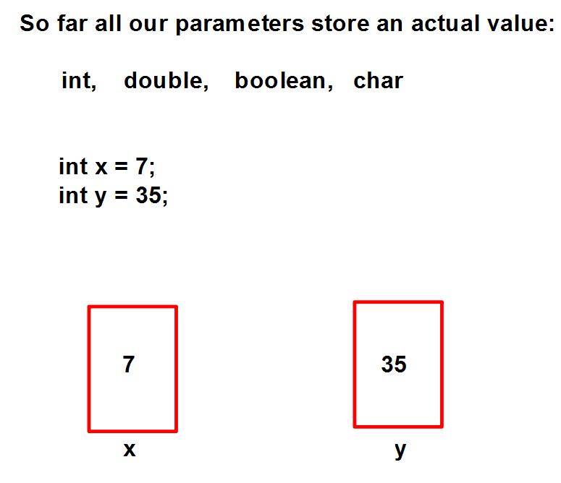

Slide 3
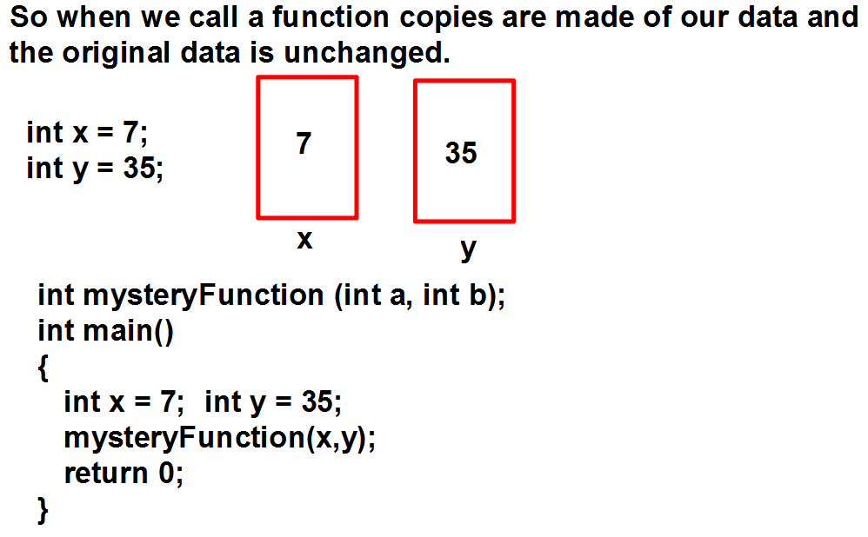

Slide 4
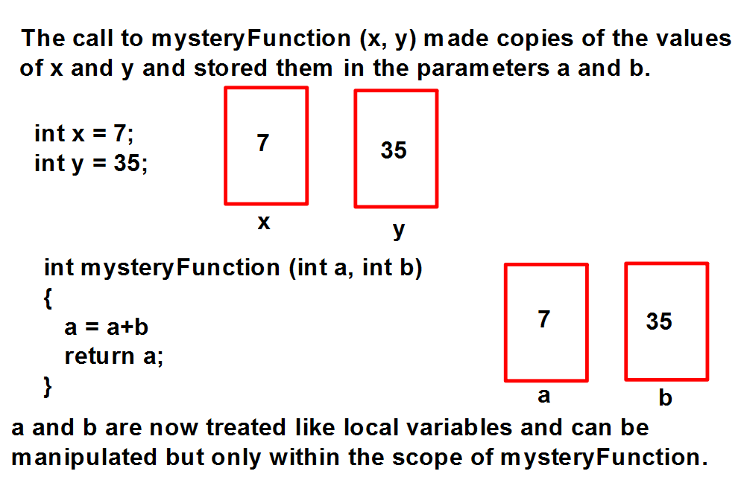

Slide 5
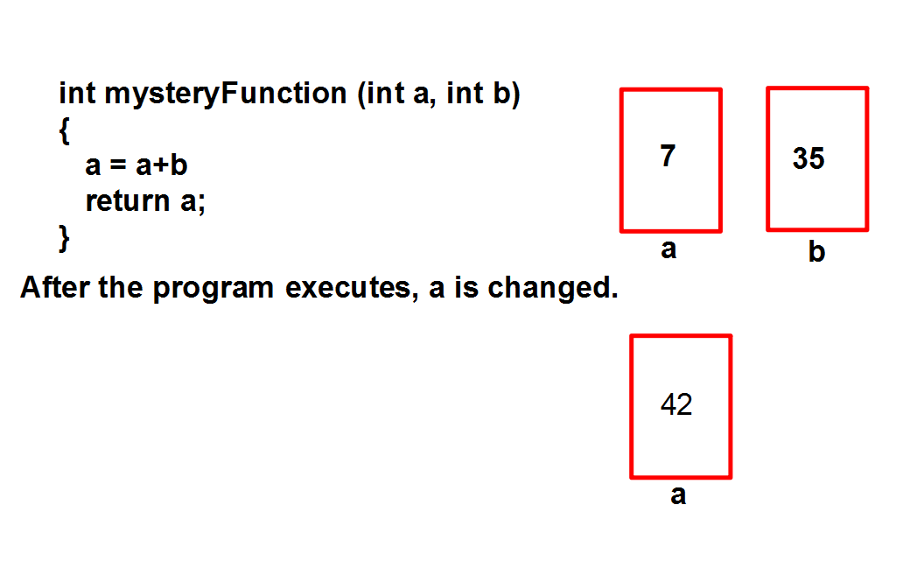

Slide 6
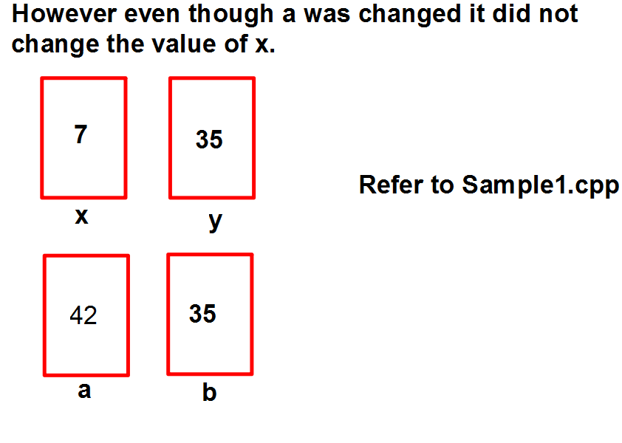

Slide 7
This process is called passing parameters by value.
Basically a copy of the value is made and sent to the parameters.
These values can then be manipulated w/o altering the original data
of the main program.
… but what if we wanted to change the values of the original data???

Slide 8
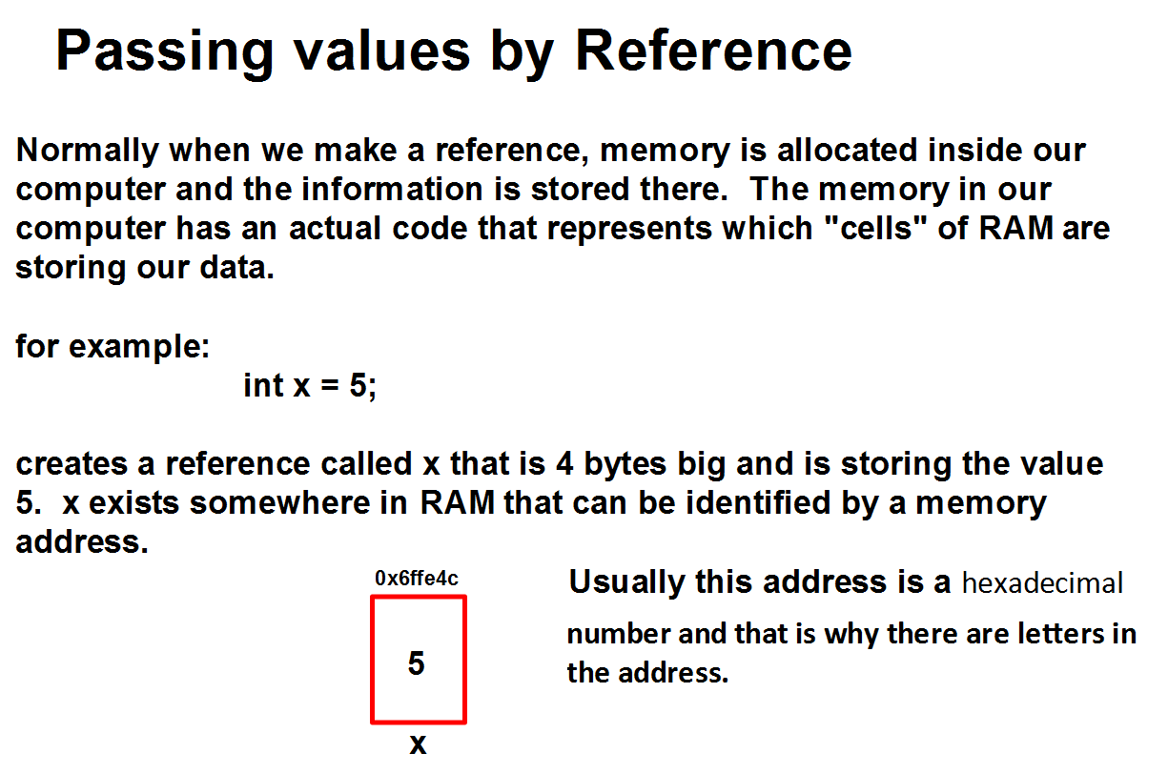

Slide 9
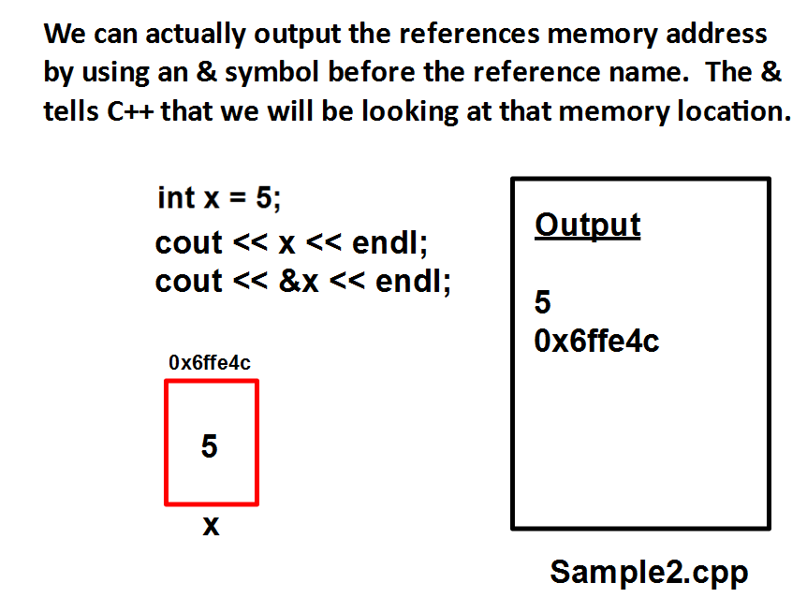

Slide 10
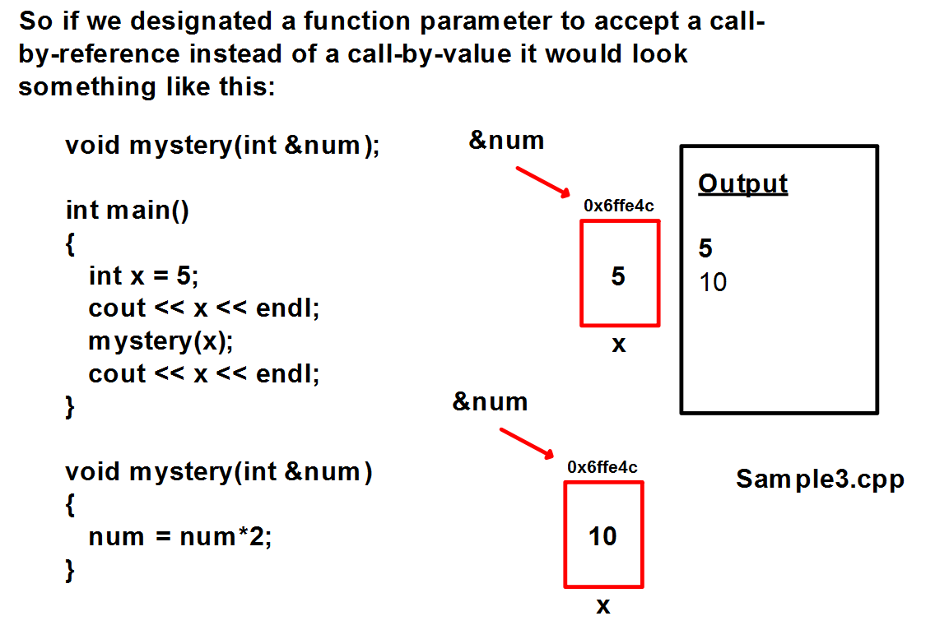

Slide 11
Hand Trace
Sample4.cpp

